Slide 1
OPERATING SYSTEMS (CS F372) CPU Scheduling
Barsha Mitra
CSIS Dept., BITS Pilani, Hyderabad Campus

Slide 2
Basics
Maximum CPU utilization obtained with multiprogramming
CPU–I/O Burst Cycle – Process execution consists of a cycle of CPU execution and I/O wait
CPU burst followed by I/O burst
More number of short CPU bursts and less number of long CPU bursts

Slide 3
CPU Scheduler
Short-term / CPU scheduler selects from among the processes in ready queue for CPU allocation
CPU scheduling decisions
running to waiting state
running to ready state
waiting to ready
terminates
Preemptive scheduling – done in situations 2 and 3
Nonpremptive /Cooperative scheduling – once a process is allocated the CPU it retains the CPU until termination or switching to waiting state

Slide 4
Dispatcher
Dispatcher module gives control of the CPU to the process selected by the short-term scheduler; this involves:
switching context
switching to user mode
jumping to the proper location in the user program to restart that program
Dispatch latency – time for the dispatcher to stop one process and start another running

Slide 5
Scheduling Criteria
CPU utilization – keep the CPU as busy as possible
Throughput – no. of processes that complete their execution per time unit
Turnaround time – amount of time to execute a particular process, interval from submission time to completion time, sum of durations spent waiting to get into memory, waiting in ready queue, executing on CPU, doing I/O
Waiting time – amount of time a process has been waiting in the ready queue
Response time – amount of time it takes from when a request was submitted until the first response is produced, not output (for time-sharing environment), depends on the speed of output device

Slide 6
FCFS: Example 1
Draw Gantt chart
Compute the average wait time, TAT and RT for processes
Process | AT | BT | FT | TAT | WT | RT
P1 | 0 | 7
P2 | 0 | 3
P3 | 0 | 4
P4 | 0 | 6

Slide 7
FCFS: Example 2
Draw Gantt chart
Compute the average wait time, TAT and RT for processes
Process | AT | BT | FT | TAT | WT | RT
P1 | 0 | 7
P2 | 8 | 3
P3 | 3 | 4
P4 | 5 | 6

Slide 8
FCFS: Example 3
Draw Gantt chart
Compute the average wait time, TAT and RT for processes
Process | AT | BT | FT | TAT | WT | RT
P1 | 0 | 2
P2 | 3 | 1
P3 | 5 | 5

Slide 9
FCFS with I/O
Process | AT | BT & I/O | FT | TAT | WT | RT
P1 | 0 | 3, 5, 2
P2 | 2 | 4, 3, 3
P3 | 4 | 4
P4 | 6 | 3, 2, 3
Assume a process does not wait at the I/O device queue.

Slide 10
Shortest-Job-First (SJF) Scheduling
Associate with each process the length of its next CPU burst
Use these lengths to schedule the process with the shortest next CPU burst
Use FCFS in case of tie
SJF is optimal – gives minimum average waiting time for a given set of processes
How to know the length of the next CPU burst
For long-term (job) scheduling in a batch system, use the process time limit that a user specifies when the job is submitted

Slide 11
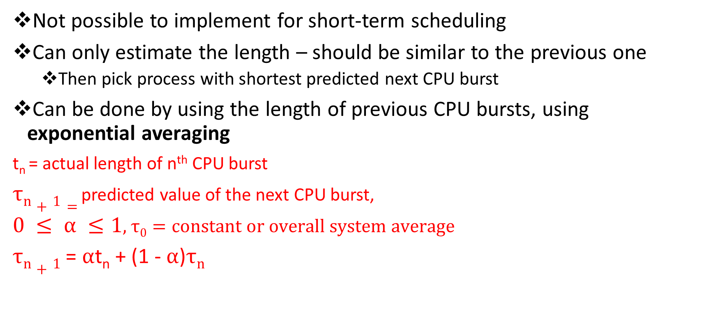
Determining Length of Next CPU Burst
Not possible to implement for short-term scheduling
Can only estimate the length – should be similar to the previous one
Then pick process with shortest predicted next CPU burst
Can be done by using the length of previous CPU bursts, using exponential averaging
t_{n} = actual length of n^{th} CPU burst
$τn+1=$predicted value of the next CPU burst,
$0 ≤ α ≤1$, $τ0=constant or overall system average$
$τn+1$ = $α$t_{n} + (1 - $α$)$τn$

Slide 12
Prediction of Length of Next CPU Burst
If we expand the formula, we get:
τ_{n+1} = α t_{n}+(1 - α)α t_{n} ₋₁ + … +(1 - α )^{j} α t_{n} _{-j} + … +(1 - α )^{n +1} τ₀
τ₀ – constant or system average
Since both α and (1 - α) are less than or equal to 1, each successive term has less weight than its predecessor
Commonly, α set to ½

Slide 13
Shortest-Job-First (SJF) Scheduling
Can be nonpreemptive or preemptive
Preemptive version called shortest-remaining-time-first (SRTF)

Slide 14
SJF: Example 1
Draw Gantt chart
Compute the average wait time, TAT and RT for processes
Process | AT | BT | FT | TAT | WT | RT
P1 | 0 | 7
P2 | 0 | 3
P3 | 0 | 4
P4 | 0 | 6

Slide 15
SJF: Example 2
Draw Gantt chart
Compute the average wait time, TAT and RT for processes
Process | AT | BT | FT | TAT | WT | RT
P1 | 0 | 7
P2 | 8 | 3
P3 | 3 | 4
P4 | 5 | 6

Slide 16
SJF with I/O
Process | AT | CPU- BT & I/O BT | Total BT | FT | TAT | WT | RT
P1 | 0 | (4 – 2 – 4)
P2 | 0 | (5 – 2 – 5)
P3 | 0 | (2 – 2 - 2)
Assume a process does not wait at the I/O device queue.

Slide 17
SRTF: Example
Draw Gantt chart
Compute the average wait time, TAT and RT for processes
Process | AT | BT | FT | TAT | WT | RT
P1 | 0 | 7
P2 | 8 | 3
P3 | 3 | 2
P4 | 5 | 6

Slide 18
Priority Scheduling
A priority number (integer) is associated with each process, generally starting from 0
CPU is allocated to the process with the highest priority (smallest integer ≡ highest priority), tie broken using FCFS
Preemptive
Nonpreemptive
SJF is priority scheduling where priority is the inverse of predicted next CPU burst time
Problem ≡ Starvation/Indefinite blocking – low priority processes may never execute
Solution ≡ Aging – as time progresses increase the priority of the process

Slide 19
Priority (non-preemptive): Example
Draw Gantt chart (Lower Number Higher priority, )
Compute the average wait time, TAT and RT for processes
Process | AT | BT | Pri | FT | TAT | WT | RT
P1 | 0 | 3 | 5
P2 | 2 | 2 | 3
P3 | 3 | 5 | 2
P4 | 4 | 4 | 4
P5 | 6 | 1 | 1

Slide 20
Priority (preemptive): Example
Draw Gantt chart
Compute the average wait time, TAT and RT for processes
Process | AT | BT | Pri | FT | TAT | WT | RT
P1 | 0 | 3 | 5
P2 | 2 | 2 | 3
P3 | 3 | 5 | 2
P4 | 4 | 4 | 4
P5 | 6 | 1 | 1

Slide 21
Round Robin (RR) Scheduling
Each process gets a small unit of CPU time (time quantum q), usually 10-100 milliseconds. After this time has elapsed, the process is preempted and added to the end of the ready queue.
If there are n processes in the ready queue and the time quantum is q, then each process gets 1/n of the CPU time in chunks of at most q time units at once. No process waits more than (n-1)q time units until its next time quantum.
Performance
q large ⇒ FCFS
q small ⇒ q must be large with respect to context switch

Slide 22
Round Robin (RR) Scheduling
Process Burst Time
P₁ 28
P₂ 3
P₃ 3
P₄ 20
Typically, higher average turnaround than SJF, but better response
AT = 0, q = 4 ms

Slide 23
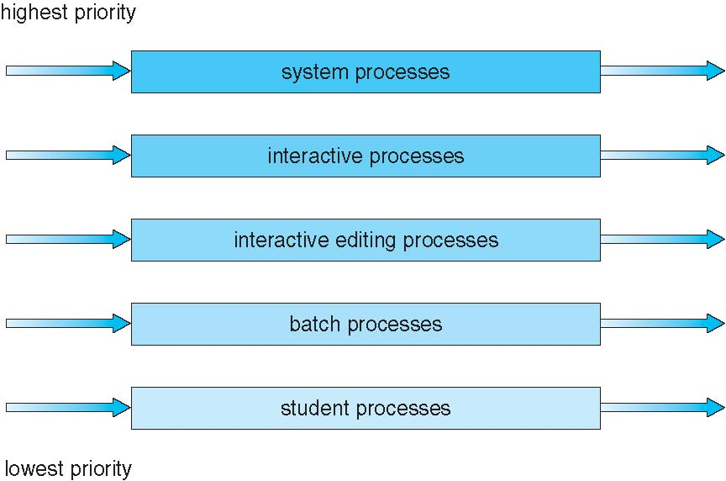
Multilevel Queue Scheduling
fixed priority preemptive scheduling among queues

Slide 24
Multilevel Feedback Queue
A process can move between the various queues; aging can be implemented this way
Separate processes according to the characteristics of their CPU bursts
Parameters considered:
number of queues
scheduling algorithms for each queue
method used to determine when to upgrade a process
method used to determine when to demote a process
method used to determine which queue a process will enter when that process needs service

Slide 25
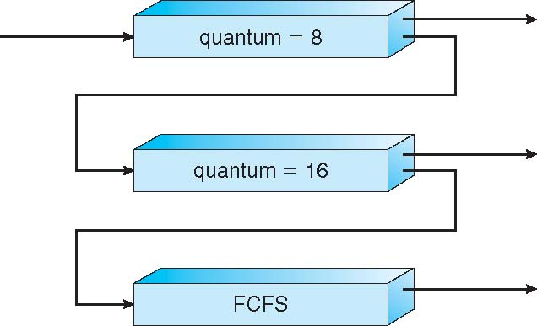
Multilevel Feedback Queue
Three queues:
Q₀ – RR with time quantum 8 milliseconds
Q₁ – RR time quantum 16 milliseconds
Q₂ – FCFS
Scheduling
A new process enters queue Q₀ which is uses RR
When it gains CPU, job receives 8 milliseconds
If it does not finish in 8 milliseconds, job is moved to queue tail of Q₁
At Q₁ process is again served using RR and receives 16 additional milliseconds
If it still does not complete, it is preempted and moved to tail of queue Q₂

Slide 26
Thread Scheduling
Distinction between user-level and kernel-level threads
When threads supported, threads scheduled, not processes
Many-to-one and many-to-many models, thread library schedules user-level threads to run on LWP
Scheme is known as process-contention scope (PCS) since scheduling competition is within the process (local contention scope)
Typically done via priority set by programmer
Kernel thread scheduled onto available CPU is system-contention scope (SCS) – competition among all threads in system (global contention scope)

Slide 27
Pthread Scheduling
API allows specifying either PCS or SCS during thread creation, contention scope values
PTHREAD_SCOPE_PROCESS schedules threads using PCS scheduling
PTHREAD_SCOPE_SYSTEM schedules threads using SCS scheduling
Can be limited by OS – Linux and Mac OS X only allow PTHREAD_SCOPE_SYSTEM
On systems implementing the M:M model, PTHREAD_SCOPE_PROCESS policy schedules user-level threads onto available LWPs
PTHREAD_SCOPE_SYSTEM policy will create and bind an LWP for each user-level thread effectively mapping a user-level thread to a kernel level thread

Slide 28
Pthread Scheduling
pthread_attr_setscope(pthread_attr_t *attr, int scope)
pthread_attr_getscope(pthread_attr_t *attr, int *scope)
On success, these functions return 0; on error, they return a nonzero error number

Slide 29
Pthread Scheduling
#include <pthread.h>
#include <stdio.h>
#define NUM_THREADS 5
int main(int argc, char *argv[]) {
int i, scope; pthread_t tid[NUM_THREADS];
pthread_attr_t attr;
/* set the default attributes */
pthread_attr_init(&attr);
/* first inquire on the current scope */ if (pthread_attr_getscope(&attr, &scope) != 0)
fprintf(stderr, “Error\n");
else {
if (scope == PTHREAD_SCOPE_PROCESS)
printf("PTHREAD_SCOPE_PROCESS");
else if (scope == PTHREAD_SCOPE_SYSTEM)
printf("PTHREAD_SCOPE_SYSTEM");
else fprintf(stderr, "Illegal scope value.\n");
}
/* set the scheduling algorithm to SCS */
pthread_attr_setscope(&attr, PTHREAD_SCOPE_SYSTEM);
/* create the threads */ for (i = 0; i < NUM_THREADS; i++)
pthread_create(&tid[i],&attr,runner,NULL);
/* now join on each thread */ for (i = 0; i < NUM_THREADS; i++)
pthread_join(tid[i], NULL);
}
/* Each thread will begin control in this function */
void *runner(void *param) {
/* do some work ... */
pthread_exit(0);
}

Slide 30
CFS
default scheduler of Linux kernel
red-black tree
processes are given a fair amount of processor time
keeps track of the amount of processor time provided to a process – virtual runtime
smaller a process’s virtual runtime implies the process has been permitted to access processor for a smaller amount of time, hence higher is the need for processor
https://opensource.com/article/19/2/fair-scheduling-linux

Slide 31
Thank You

